Slide 1
MBTA Retirement Fund: Overview of Changes to the Pension Agreement
MBTA Retirement Fund Staff
June 23, 2023

Slide 2
Table of Contents
Introduction
Background and Overview of this Presentation 3
Two-Tier Pension Benefit Structure
Overview of Membership in the Two-Tier Pension Benefit Structure 4
Group A Plan Member Application to Join Group B Plan 5
Retirement Benefits (Non-Disability and Non-Vesting) 6-9
Vested Retirement Benefits 10-12
Disability Retirement Allowance 13-14
Returning and Retaining Member Contributions 15
Other Changes to the Pension Agreement
Increase in Contribution Rate; PRIT Investments 16
Rehiring of Retired Members 17
Cost of Living Adjustments for Retired Members 18
Conclusion and Questions
Questions 19

Slide 3
Background and Overview of this Presentation
Memorandum of Understanding. On March 31, 2023, the Massachusetts Bay Transportation Authority (Authority) and the Local 589, Amalgamated Transit Union, AFL-CIO (Union) entered into a Memorandum of Understanding (MOU) making important changes to the Pension Agreement. The MOU supersedes the arbitration award of August 26, 2022, which has been vacated and has no further effect.
Purpose of Presentation. The Fund knows that your pension benefits are important to you. It is, therefore, the Fund’s mission to help you understand your benefits so you can make informed career, retirement, and life decisions. To assist in that effort, the Fund prepared this presentation to provide you with a summary overview of the changes the MOU made to the Pension Agreement. You are, however, encouraged to review the MOU and, when available in a consolidated version, the revised Pension Agreement.
MOU. The MOU is currently available on the Fund’s website.
Revised Pension Agreement. When complete, the revised Pension Agreement will also be posted on the Fund’s website.
Available to Answer Questions. The Fund is ready and available to answer any questions that you have about the MOU and the changes it made to Pension Agreement.

Slide 4
Overview of Membership in the Two-Tier Pension Benefit Structure
Creation of Two-Tier Structure. The new Pension Agreement created a two-tier pension benefit structure: (i) the Group A Plan, and (ii) the Group B Plan.
Group A Plan Membership. Employees who are or become Members of the Fund on or before June 30, 2023, are automatically in the Group A Plan unless they elect to be in the Group B Plan.
Group B Plan Membership.
Automatic Membership. Employees who are or become Members of the Fund on or after July 1, 2023, are automatically in the Group B Plan.
Electing to Join Group B. Members in the Group A Plan may elect to join the Group B Plan. For a Group A Plan Member to join the Group B Plan, the Member must meet the following conditions:
The Member must elect to join the Group B Plan by providing written notification to the Fund between June 30, 2023, and December 31, 2023, by completing the Group B Plan Election Form on the Fund’s website or by mailing the Form to the MBTARF (which must be postmarked by 12/31/2023); and
The Member must accumulate at least 24 months of creditable service after such election.
Transferring to Group A. A Member in the Group B Plan may not transfer (or transfer back) to the Group A Plan.
Important Consideration Related to QDROs. Group A Plan Members who have a QDRO in place should consult with their attorney before transferring to the Group B Plan to ensure that a retirement under the Group B Plan does not require changes to their QDRO.

Slide 5
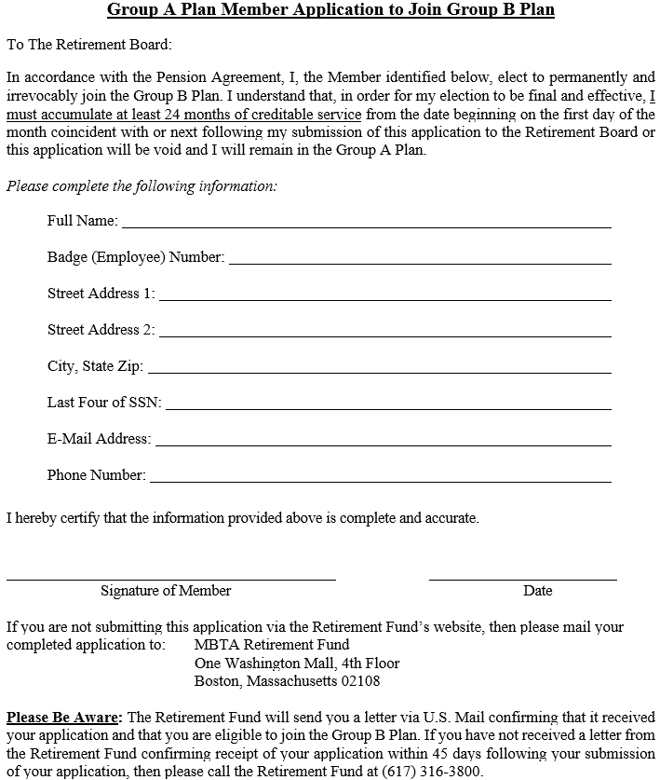
Group A Plan Member Application to Join Group B Plan

Slide 6
Group A Plan Retirement Benefits (Non-Disability and Non-Vesting)
Retirement Eligibility. Unless otherwise subject to retirement benefits under the Group B Plan:
Normal Retirement. A Member can retire at age 65 or older on a Normal Retirement.
Early Normal Retirement. An Early Normal Retirement is available to any Member with 23 years of creditable service if such Member was hired before December 6, 2012. For Members hired on or after December 6, 2012, who became Members of the Fund on or before June 30, 2023, an Early Normal Retirement is available if such Member is age 55 or older and has at least 25 years of creditable service.
Early Reduced Retirement. For individuals who became Members of the Fund on or before June 30, 2023, an Early Reduced Retirement is available if a Member is age 55 or over and has at least 20 years of creditable service; however, this retirement allowance will be reduced by ½ of 1% for each month between the age at retirement and age 65.
Calculation of Pension Benefits. Except as provided above, a Member’s retirement allowance is calculated using the following formula:
[the average of the Member’s highest 3 years of pensionable earnings];
multiplied by 2.46%;
multiplied by [the Member’s years and months of creditable service].
Maximum Retirement Benefit. A Retired Member’s retirement allowance cannot exceed 80% of the average of the Retired Member’s highest 3 years of pensionable earnings.

Slide 7
Group B Plan Retirement Benefits (Non-Disability and Non-Vesting)
Retirement Eligibility. A Member with at least 10 years of creditable service who has also reached the age of 55 is eligible to retire with an immediate retirement allowance.
Calculation of Pension Benefits. A Member’s retirement allowance is calculated using the following formula:
[the average of the Member’s highest 3 years of pensionable earnings];
multiplied by [the Age Multiplier], which is determined using the following table:
multiplied by [the Member’s years and months of creditable service].
Maximum Retirement Benefit. A Retired Member’s retirement allowance cannot exceed 80% of the average of the Retired Member’s highest 3 years of pensionable earnings.
Age at Retirement | Percentage
61 or over | 2.46%
60 | 2.375%
59 | 2.25%
58 | 2.125%
57 | 2.0%
56 | 1.875%
55 | 1.75%

Slide 8
Retirement Calculation Example (Non-Disability and Non-Vesting)
Seth, aged 53, became a Member in Jan. 2015 at age 45. His 3 Year Average (3YA) will be $80,000 when he retires.
Calculation Under Group A Plan:
Seth is eligible for retirement when he accrues 25 years of creditable service and is at least age 55. He currently has 8 years on and will be retirement eligible Jan. 2040. His pension will be calculated as such:
2.46% x 25 = 61.5% of his 3YA ($80,000)
61.5% x $80,000 = $49,200 annually or $4,100 monthly
Calculation Under Group B Plan:
Seth is eligible for retirement when he accrues at least 10 years of creditable service on and is at least 55 years of age. He currently has 8 years on and will be retirement eligible at age 55 when he completes 2 more years of creditable service, then with 10 years of creditable service and a reduced Group B Age Multiplier of 1.75%.
1.75% x 10 = 17.5% of his 3YA ($80,000)
17.5% x $80,000 = $14,000 annually or $1,166.67 monthly _________________________________________
If he retires 6 years later at age 61, his pension will be calculated using the maximum Group B Age Multiplier, 2.46%:
2.46% x 16 = 39.36% of his 3YA ($80,000)
39.36% x $80,000= $31,488 annually or $2,624 monthly

Slide 9
Retirement Calculation Example: Early Normal Retirement
John Smith joined the Fund in July of 2002 at 25 years of age. Next month he will qualify for an Early Normal Retirement at 23 years of Creditable Service in Group A. His 3 year average (3YA) is $90,000.
Calculation Under Group A Plan:
John will have 23 years of creditable service in July 2025 and will be 48 years old.
In July 2025 he can apply for an Early Normal Retirement with 23 years of creditable service
23x 2.46% = 56.58% of his 3YA ($90,000)
56.58% x $90,000 = $50,922 annually or $4243.50 monthly
Calculation Under Group B Plan:
If John joins the Group B plan and accumulates two more years of creditable service, he will have 25 years of creditable service in July of 2025.
Because John is 48 years old, he will not qualify for a retirement until he is 55 years old in 2032.
He could leave the MBTA and defer his retirement, but would not receive his maximum retirement until he was 65 years of age in 2042.
He could receive a reduced vested retirement allowance prior to the age of 65 but with a 6% per year reduction, as further discussed in the next two slides.

Slide 10
Vested Retirement Benefits
Vesting – Group A Plan.
Eligibility Requirements for Vesting Under Group A. A Member who has at least 10 years of creditable service and does not receive a return of contributions qualifies for a vested retirement benefit if such Member’s employment with the Authority ended through no fault of their own. If a Member resigns or is discharged for cause, then the former Member is not eligible for a vested retirement benefit.
Vesting Retirement Benefit Under Group A. A vested Member is eligible to receive a retirement benefit the first of the month following or coincident with such vested Member’s 65th birthday. A vested retirement allowance is calculated as follows: 50 percent of Normal Retirement Allowance (see Slide No. 6) if the Member has completed 10 years of Creditable Service up to the time such Member’s employment terminates plus 5 percent of Normal Retirement Allowance for each additional year of creditable service up to 20 years total service.
Vesting – Group B Plan.
Eligibility Requirements for Vesting Under Group B. A Member of the Group B Plan shall have a fully vested deferred retirement allowance if the following conditions are satisfied: (i) the Member has accrued 10 or more years of creditable service; (ii) the Member’s service with the Authority was terminated for any reason prior to such Member becoming eligible for a retirement allowance set out in accordance with Article IV(2); and (iii) the Member has not withdrawn their contributions from the Fund.
Vesting Retirement Benefit Under Group B. A vested Member’s retirement allowance is calculated using the following formula:
[the average of the Member’s highest 3 years of pensionable earnings];
multiplied by 2.46%;
multiplied by [the Member’s years and months of creditable service].
Reduction if Retiring Before Age 65. However, if a vested Member retires prior to the age of 65, then such vested Member’s retirement allowance will be reduced, for such Member’s entire retirement, by 6% per year, or ½ of 1% for each month, of retirement before age 65.

Slide 11
Retirement Calculation Example: Vested Retirement Deferred Vested Retirement
Amelia joined the Fund in July 2015 at age 43. Her 3 Year Average (3YA) will be $76,000 when she retires.
Calculation Under Group A Plan:
Amelia will be 65 years of age in Nov. 2036 and will qualify for a Normal Retirement because of her age 65.
21.3333 x 2.46% = 52.48% of her 3YA ($76,000)
52.48% x $76,000 = $39,884.80 annually or $3,323.73 monthly
Calculation Under Group B Plan:
Amelia will be 54 years of age in Nov. 2025 and will have completed 10 years of creditable service. Since she is under 55 years of age, she has the option to defer her vested retirement until she reaches age 65. If she defers, her multiplier will be the maximum Group B Age Multiplier 2.46%.
10.3333 x 2.46% = 25.42% of her 3YA ($76,000)
25.42% x $76,000 = $19,319.20 annually or $1,609.93 monthly

Slide 12
Retirement Calculation Example: Vested Retirement Benefit Layoff/ Immediate
Amelia joined the Fund in July 2015 at age 43. She will be laid-off in November 2026. Her 3 Year Average (3YA) will be $80,000 when she retires.
Calculation Under Group A Plan:
Amelia will be 55 years of age in Nov. 2026. She will have to wait 10 years until age 65 in order to collect a pension that roughly equals 15.33% of her 3YA.
11 years x 5% per year = 55% of normal benefit
55% x 11.3333 years x 2.46% x $80,000 = $12,264 annually or $1,022 monthly
Calculation Under Group B Plan:
Amelia will be 55 years of age in Nov. 2026 and will have completed 11 years of creditable service. Since she is 55 years of age, she would not be eligible for a vested retirement allowance and would be required to take a standard retirement using the formula set out in Slide No. 7 and the Age Multiplier for age 55 (1.75%).
11.3333 x 1.75% = 19.83% of her 3YA ($80,000)
19.83% x $80,000 = $15,864 annually or $1,322 monthly

Slide 13
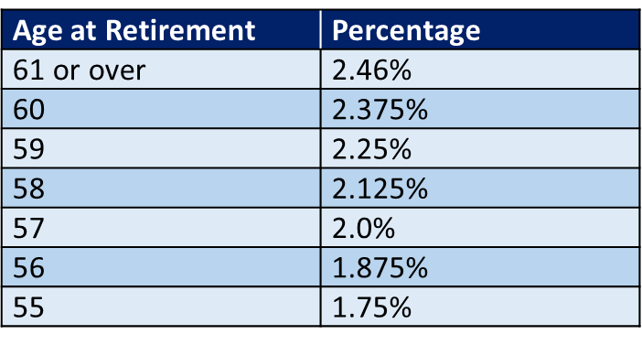
Disability Retirement Allowance
Eligibility for Disability Retirement Allowance. For Members in either the Group A Plan or Group B Plan, a Member is required to accumulate 4 years of creditable service to be eligible for an occupational disability and required to accumulate 6 years of creditable service to be eligible for a non-occupational disability.
Minimum Disability Retirement Allowance. For Members in either the Group A Plan or Group B Plan, a Member receiving a disability retirement allowance will receive a minimum of 15% of the average of such Member’s highest 3 years of pensionable earnings.
Calculation of Disability Benefit Allowance.
Group A Plan. A disability retirement allowance under the Group A Plan is calculated using the following formula:
[the average of the Member’s highest 3 years of pensionable earnings];
multiplied by 2.46%;
multiplied by [the Member’s years and months of creditable service].
Group B Plan. A disability retirement allowance under the Group B Plan is calculated using the following formula:
[the average of the Member’s highest 3 years of pensionable earnings];
multiplied by [the Age Multiplier], which is determined using the following table; provided, however, that the Age Multiplier is based on the Member retiring at the age of 55 or the Member’s age at the time of disability retirement if the Member is over the age of 55;
multiplied by [the Member’s years and months of creditable service].

Slide 14
Retirement Calculation Example: Disability Retirement Allowance
Lance joined the Fund in August 2008 at aged 27. His 3 Year Average (3YA) will be $88,000 when he retires. If he were to become injured in the future, his November 2027 calculation would be calculated as follows:
Calculation Under Group A Plan:
Lance will have 19.25 years of creditable service in Nov. 2027.
19.25 x 2.46% = 47.36% of his 3YA ($88,000)
47.36% x $88,000 = $41,672 annually or $3,472 monthly
Calculation Under Group B Plan:
Lance will have 19.25 years of creditable service in Nov. 2027 and will be 46 years of age. Since he is younger than 55, he will receive the reduced age multiplier as if he were 55 years of age.
19.25 x 1.75% = 33.69% of his 3YA ($88,000)
33.69% x $88,000 = $29,645 annually or $2,470 monthly

Slide 15
Returning and Retaining Member Contributions
Group A Plan Members. A Group A Plan Member that ceases to be an employee for any cause other than death or retirement may not elect to keep their contributions in the Fund. For a Group A Plan Member to have their creditable service restored, such Member is required to meet the requirements of the service buyback provisions of Article III(3), which require the Member to complete 3 years of creditable service and repay their withdrawn contributions to regain their creditable service.
Group B Plan Members.
Election to Retain Contributions at the Fund. Members in the Group B Plan who cease to be employed with the Authority may elect, upon written notification to the Fund on the Fund’s designated application for return of contributions form, to keep their contributions in the Fund in order to maintain and resume creditable service in the event any such former Member is rehired by the Authority and becomes a Member of the Fund again in the future.
Obtaining a Return of Contributions. Any former Group B Plan Member who does not make such election to keep their contributions in the Fund and receives a return of their contributions will not have their creditable service restored when such Member becomes a Member of the Fund again unless such Member meets the requirements of the service buyback provisions of Article III(3), which require the Member to complete 3 years of creditable service and repay their withdrawn contributions to regain their creditable service.

Slide 16
Increase in Contribution Rates; PRIT Investments
Active Member Contribution Rate. The changes to the Pension Agreement increase Active Member’s individual contributions by 1.25% over the actuarial annual required contribution rate beginning with the first full pay period after July 1, 2023. This means that the Active Members Contribution rate will be 10.3489% beginning on July 1, 2023.
Authority Contribution Rate. The changes to the Pension Agreement require the Authority’s contributions to be maintained at a minimum floor of 25.8161% of payroll, paying increased amounts if prescribed by the actuarial annual required contribution rate until the unfunded amount of the plan is less than 20%, as determined by the MBTARF’s actuary. This means that the Authority’s matching contributions will be 25.9511% beginning on July 1, 2023.
Investment in PRIT. The changes to the Pension Agreement require the Fund to use its best efforts, subject to the Trustees’ exercising their fiduciary and investment obligations, to transfer 50% of the market value of the Fund’s portfolio of assets, as of April 30, 2023, to the Pension Reserves Investment Trust (PRIT) within five (5) years of March 31, 2023.

Slide 17
Rehiring of Retired Members
New Mechanism in the Pension Agreement. The changes to the Pension Agreement include a new, limited mechanism for the Authority to rehire Retired Members.
Amount of Rehired Retired Members. The Authority may rehire and retain, pursuant to the Pension Agreement, a maximum of 125 total Retired Members at any given time.
Hours Permitted to be Worked by Retired Members. So long as the employment of a rehired Retired Member does not exceed 1,200 hours per calendar year, such rehired Retired Member’s service will not impact, alter or impair the Rehired Member’s retirement allowance or count toward creditable service.

Slide 18
Cost of Living Adjustments for Retired Members
COLA Raises. Retired Members or their beneficiaries receiving retirement allowances as of June 30, 2018, who are also still living as of March 31, 2023, will receive a one-time “ad-hoc” 2% to 5% cost of living adjustment (COLA) to the first $13,000 of their annual retirement allowances in effect as of June 30, 2018.
COLA Adjustment Rates. The COLA adjustments are based on retirement date, as set out in the table below.
Retirement Date | Percentage Increase on First $13,000 of Annual Retirement Allowance | Annual Increase on First $13,000 of Annual Allowance | Monthly Increase on First $13,000 of Annual Allowance | One-Time Retroactive Payment
Before 1999 | 5% | $ 650 yearly | $ 54.17 monthly | $3,250
1999 – 2006 | 4% | $ 520 yearly | $ 43.33 monthly | $2,600
2007 – 2011 | 3% | $ 390 yearly | $ 32.50 monthly | $1,950
2012 – June 2018 | 2% | $ 260 yearly | $ 21.67 monthly | $1,300
July 2018 – Present | No increase | No increase | No increase | None
Retirees with annual retirement allowances less than $13,000 that qualify for a COLA adjustment will have their annual retirement allowance multiplied by the percentage in the table above based on their retirement date. For example, if a retiree has a $10,000 annual retirement allowance and a retirement date in 2005, then such retiree is subject to a 4% raise (Row 2, 1999 – 2005), which would be multiplied by the retiree’s $10,000 annual retirement allowance for a $400 annual COLA increase or a $33.33 monthly COLA increase ($400/12= $33.33). | a | a | A

Slide 19
Questions?

